Slide 1
Contextual Task Analyses
Chapter 03
Usability Engineering Life Cycle by
Deborah J. Mayhew

Slide 2
How today’s lecture works
HOW TODAY WORKS
look for these badges in the top-left of a slide
POLL
Vote with your hands — everyone answers, no one is wrong.
QUIZ
Answer on paper first; the next slide reveals the answer.
THINK-PAIR-SHARE
1 min alone → 2 min with your neighbour → a few pairs share.
LIVE EXERCISE
Do it now, in class, on paper.
CASE PUZZLE
A real situation; apply today’s idea to it in pairs.
Today: contextual task analysis (Mayhew Ch. 3) — Stage 1 background → Stage 2 observe → 10-min break → Stage 2 analyse → Stage 3 task organisation; 13 activities
Have ready: a sheet of paper and a pen
Notes:
2-hour session, one deck. 0:00 warm-up + process model · 0:12 Stage 1 (Steps 1–4) · 0:36 Stage 2: how to observe · 0:48 break · 0:58 Stage 2: what to record, environment, scenarios, documenting · 1:42 Stage 3 + card sort · 1:57 exit ticket.
With all three optional activities the session runs about 2 h 05 min, so plan to drop at least one.
Spend 30 seconds here: every activity slide carries one of these badges. In a POLL everyone votes, even if unsure.
Running case all session: Noor Medical Store (fictional) wants a billing-and-stock system, “MedStore POS”.
If time runs short, drop first (all marked optional): “Simple simple, complex possible”, then “Which step is this?”, then the direct/indirect poll.

Slide 3
Warm-up: the steps nobody mentions
THINK-PAIR-SHARE
5 min · 1 alone, 2 in pairs, 2 share
How do you submit an assignment on the LMS?
1 · Alone (1 min)
Write every step, in order, from “I finished the assignment” to “done”.
2 · Pairs (2 min)
Swap lists. Circle every step your partner did that you forgot to write — or did not think counts as a step.
Count them: how many steps happen outside the LMS itself?
If you only asked users, you would never hear about these steps. That is why we observe.
Notes:
THINK-PAIR-SHARE, 5 minutes. 1 alone, 2 in pairs, 2 taking a few lists.
Steps students usually forget to write: checking the WhatsApp group for the real deadline; asking a friend which file format; converting Word to PDF; renaming the file RollNo_Name; compressing it because of the size limit; taking a screenshot of the submission page as proof; logging in again later to check it really uploaded.
None of these are in any requirements document for the LMS, and few users would mention them in an interview, because they no longer notice them.
Bridge: “To obtain a user-centred model of work as it is currently performed” — next slide.

Slide 4
What is contextual task analyses?
Contextual Task Analysis is on projects in which a specific product has already been identified, defined and scoped.
To obtain a user-centered model of work as it is currently performed
Here you need to understand how users currently think about, talk about and do their work in their actual work environment.
Basic Steps are
Gather background information
Collect and analyze data from observations/interviews
Construct and validate a model of the users’ current task organization

Slide 5
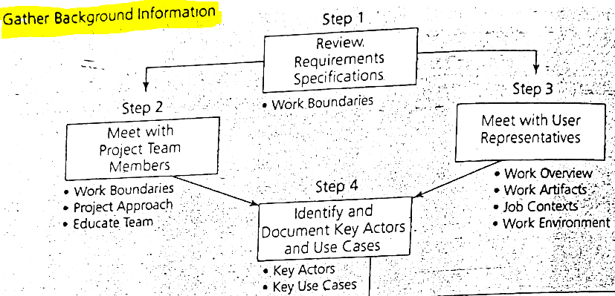
Contextual Task Analysis Process Model
1.

Slide 6
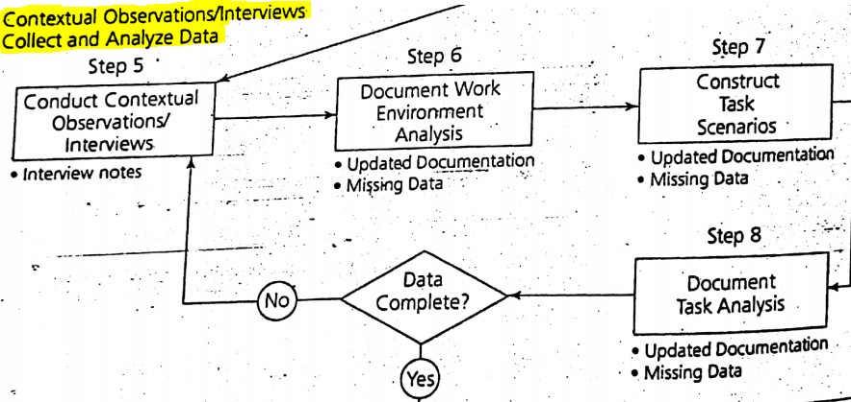
Continue…
2.

Slide 7
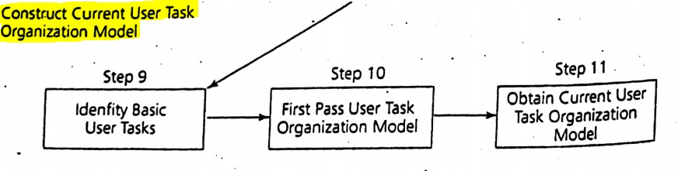
Continue…
3.

Slide 8
Today’s running case
EXAMPLE
we come back to this store in every activity
Noor Medical Store · a busy neighbourhood pharmacy on G.T. Road, Lahore (fictional)
The owner, a pharmacist, wants a billing-and-stock system to replace handwritten bills and stock registers. Working name:
MedStore POS
People
Owner (pharmacist) · 2 counter salesmen · customers · distributor’s sales rep
Hours
Open 9 am – 11 pm; evening rush 7–10 pm
Volume
About 150 sales a day; from one strip of tablets to a 12-item prescription
Today
Paper bills, a calculator, a stock register, and a notebook of credit (udhaar) customers
Mayhew’s example is a police station’s property forms; ours is a pharmacy’s bills. Same method.
Notes:
EXAMPLE, 1 minute. Introduce the case quickly; the details come out in the activities.
Why a pharmacy: every student has stood at a medical-store counter, so they can reason about the real work, the environment and the people.
The store and the system are fictional.

Slide 9
Stage 1.
Gather Background information

Slide 10
1. Review Requirement Specification or Software Requirement Specification (SRS)
A Software Requirements Specification (SRS) is a document that describes the nature of a project, software or application.
In simple words, SRS document is a manual of a project provided it is prepared before you kick-start a project/application.
SRS Document includes
purpose, scope, functional and nonfunctional requirements
software and hardware requirements
Reference: https://krazytech.com/projects/sample-software-requirements-specificationsrs-report-airline-database

Slide 11
Read between the SRS lines
THINK-PAIR-SHARE
5 min · pairs · MedStore POS
From the MedStore POS SRS (extract)
FR-1 The system shall create a sale from an item code and a quantity.
FR-2 The system shall print a bill for every sale.
FR-3 The system shall update stock after each sale.
NFR-1 The system shall respond within 2 seconds.
List four things about the real work at the counter that this SRS cannot tell you.
Think: who uses it, what they hold in their hands, how sales really happen, the shop itself, what goes wrong today.
Step 1 gives you the work boundaries — not the work itself.
Notes:
THINK-PAIR-SHARE, 5 minutes, straight after the SRS slide.
Pairs list at least four gaps; take one gap from each of five pairs and write them on the board.

Slide 12
Read between the SRS lines — answers
ANSWERS
what the document cannot tell you
From the MedStore POS SRS (extract)
FR-1 The system shall create a sale from an item code and a quantity.
FR-2 The system shall print a bill for every sale.
FR-3 The system shall update stock after each sale.
NFR-1 The system shall respond within 2 seconds.
Users
Salesmen with school-level English; one trained pharmacist; who is in a hurry, who is new
In their hands
A handwritten prescription with brand names — no item codes; spoken requests (“the blue syrup for cough”)
Real sales
Loose tablets cut from a strip; substitutes for out-of-stock brands; credit (udhaar); phone and WhatsApp orders
The shop
Evening rush, queue, road noise, load-shedding (printer off), customers leaning over the counter
What goes wrong
Unreadable handwriting, wrong strength picked, stock count out of date, interruptions mid-bill
FR-1 assumes item codes. Nobody at the counter has one. Only watching the counter shows that.
Notes:
ANSWERS. Accept any gap that is about users, tasks, environment or problems.
The point of FR-1: the SRS writer imagined the work; the salesman actually works from a handwritten prescription and brand names. That gap is what Stage 2 (contextual observation) closes.

Slide 13
2. Meet with project Team members
Conduct interview with project team members to get high level view of the jobs/tasks being automated/produce.
A good starting point to understand what the application needs to offer.
Win their confidences and assure their cooperation
This will provide context for step 5

Slide 14
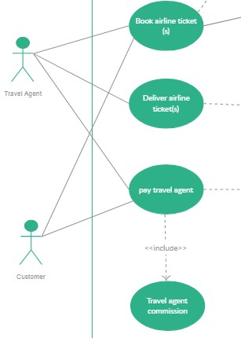
3. Meet with user representatives.
Conduct interview with user representatives (Indirect user)
i.e Travel agency customers would be indirect Users of a travel agent’s online reservation system.
Spend some time with user representatives getting a list of the main artifacts or objects, involved in the task under study.
This will give you high-level of overview of the “What” and “How” of the work task.

Slide 15
Direct or indirect user?
POLL
3 min · optional · 1 finger = direct · 2 fingers = indirect
1
Counter salesman billing a customer
2
Customer who receives the printed bill
3
Owner checking the daily sales report on his phone
4
Doctor whose prescription is entered
5
Distributor’s rep who gets the re-order list on WhatsApp
6
Owner’s accountant who gets a monthly export file
MedStore POS. Who actually operates the system, and who only lives with what it produces?
Notes:
POLL, 3 minutes (optional — drop third if short of time). Read each item; hands up with 1 or 2 fingers.
Expected split on item 3 (owner on his phone) — good: it leads into the answers.

Slide 16
Direct or indirect user? — answers
ANSWERS
direct = uses it · indirect = depends on its output
1
Counter salesman billing a customer
2
Customer who receives the printed bill
DIRECT
INDIRECT
3
Owner checking the daily sales report on his phone
4
Doctor whose prescription is entered
DIRECT
INDIRECT
5
Distributor’s rep who gets the re-order list on WhatsApp
6
Owner’s accountant who gets a monthly export file
INDIRECT
INDIRECT
Indirect users never touch the system, but its output changes their work — like the travel agency’s customers.
Notes:
ANSWERS. Item 3 is the discussion point: the owner is a direct user, but an infrequent one with a very different task (monitoring, not selling) — a different user category in the user profile.
Item 6: if the accountant logs in to pull reports himself, he becomes a direct user. The category depends on what the person does, not on the job title.

Slide 17
4. Identify and Document key Actors and Use cases.
Based on the User Profile and previous three steps identify the complete set of Actors (major user category) and Use Cases (Major types of user tasks)

Slide 18
Draw the actors and use cases
LIVE EXERCISE
8 min · pairs · on paper
MedStore POS: salesmen sell medicines (with or without a prescription), sometimes on credit, and suggest substitutes when a brand is out; the owner receives stock from distributors, returns expired stock and checks daily sales.
Your task
1. List at least 4 actors (major user categories).
2. List at least 6 use cases (major types of user tasks).
3. Draw them as a use-case diagram.
Notation (as on the travel-agent slide)
use case
system boundary
actor
Start from the user profile: each actor is a major user category.
Notes:
LIVE EXERCISE, 8 minutes in pairs, then show the answer slide.
Remind them: actors are user categories, not individual people; use cases are major task types, not screens or buttons.
Walk round and look for screen-like use cases (“click Save”, “login page”) — redirect to the task the person is trying to get done.

Slide 19
Actors and use cases — a model answer
ANSWERS
one good diagram; yours may differ
MedStore POS
Sell medicines
Suggest a substitute
Customer
indirect
Salesman
Record a credit sale
Check stock and expiry
Receive or return stock
Distributor rep
indirect
View daily sales report
Owner
Salesman and owner share “Check stock and expiry”. Indirect actors are dashed: they never operate the system.
Notes:
ANSWERS. Credit for: at least 4 sensible actors including one indirect actor; at least 6 task-level use cases; lines that make sense.
Advanced point for strong students: “Suggest a substitute” and “Record a credit sale” only happen inside “Sell medicines” — in UML they would be <<extend>> relationships, like the <<include>> on the travel-agent slide.
These use cases are what we will observe in Stage 2 and turn into task scenarios in Step 7.

Slide 20
Stage 2.
Contextual observations/interviews, Collect and Analyze data

Slide 21
5. Conduct contextual observation/interviews
This step is absolutely central to contextual task analyses.
Here, you go out and observe and talk with actual intended end users in their real work environment while they do real work.
Based on analyses of your direct observation, construct a model that represent the work from users’ point of view.

Slide 22
Contextual observation/interviews in practice
How to observe: be the apprentice
The user is the master, you are the apprentice
Learn the work by watching it being done and asking about it as it happens
Four principles of Contextual Inquiry
Context: go where the work is done
Partnership: explore the work together with the user
Interpretation: check what you think you saw with the user
Focus: know what you are looking for
“Show me” beats “Tell me”
Reference: Beyer, H. & Holtzblatt, K. (1998). Contextual Design: Defining Customer-Centered Systems. Morgan Kaufmann.
Notes:
Added slide (not in the original set), 3 minutes. It answers “how do I actually do Step 5?”.
Master–apprentice: the user does real work and explains it as it happens; you ask about what you see. Contrast with the off-site interview Mayhew warns about in the police story.
Then go straight into “Make it contextual”.

Slide 23
Make it contextual
LIVE EXERCISE
6 min · pairs · find the flaw, rewrite it for the counter
1
“Would a barcode scanner help you?”
2
“How long does a sale usually take?”
3
“Do you always check the expiry date?”
4
“Describe a typical day at the counter.”
5
“What problems do you have with the current system?”
Off-site interview questions a new analyst wrote for the Noor Medical Store salesmen.
Notes:
LIVE EXERCISE, 6 minutes in pairs. Each question is fine for a questionnaire but wastes a contextual visit. Name the flaw and rewrite it.
Expected flaws: leading/solution-first, estimate, social desirability, abstraction, recall.

Slide 24
Make it contextual — answers
ANSWERS
flaw → contextual version
1
Would a barcode scanner help you?
Asks for a solution
“Show me how you found the last thing you sold.”
2
How long does a sale usually take?
Asks for a guess
Time five real sales yourself.
3
Do you always check the expiry date?
Invites the “right” answer
Watch whether and how they check; at a pause ask “what are you doing now?”
4
Describe a typical day at the counter.
Asks for a summary
“Walk me through the customer you just served.”
5
What problems do you have with the current system?
Too general; relies on memory
When a sale goes wrong, ask what they were trying to do at that moment.
Rule of thumb: ask about this sale, in this shop, while it happens — “show me” beats “tell me”.
Notes:
ANSWERS. Link to the master–apprentice slide: an apprentice does not ask the master to describe the job in general; he watches a real piece of work and asks about it.
Item 3: people say “always” because it is the right answer. What they do in the 9 pm rush can be different. Only observation shows that.

Slide 25
10-minute break
HOW TODAY WORKS
back in 10 minutes
Done: Stage 1 — background, actors and use cases — and how to observe and interview in context.
Next: what to record, the work environment, task scenarios, the task analysis document, and the users’ own task organisation.
Notes:
Break, 10 minutes. Restart on time with “What information you need to determine?”.

Slide 26
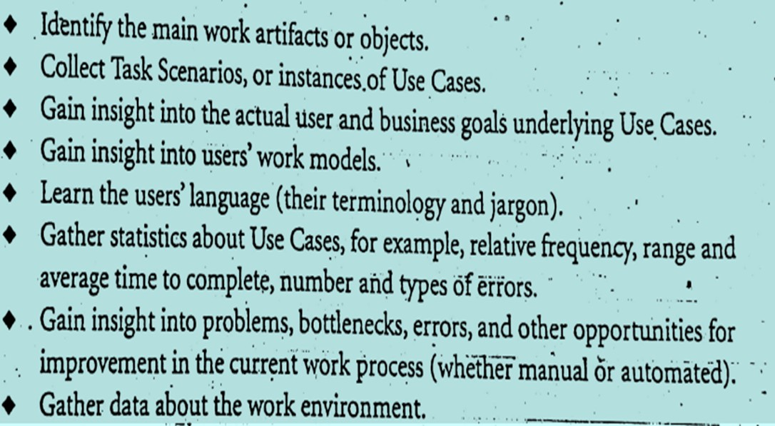
What information you need to determine?

Slide 27
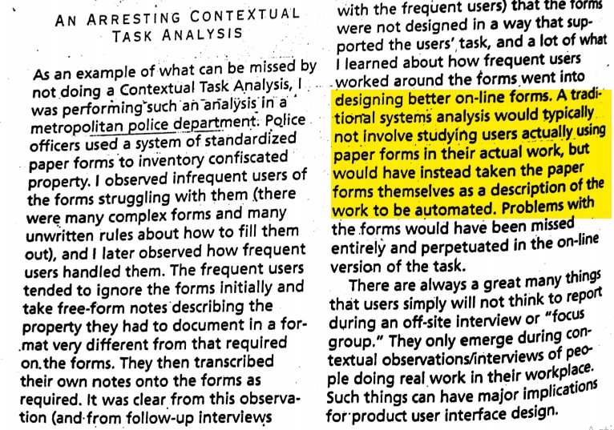

Slide 28
The notebook on the counter
CASE PUZZLE
5 min · pairs · our version of the police forms story
Observed 7–9 pm. A pilot version of MedStore POS opens a “New Sale” form with 9 required fields (customer, phone, doctor, item code, batch, quantity, price, discount, payment). In the rush the salesman ignores it: he writes each sale in a notebook, and types them all into the PC at 11 pm after closing.
A forms-only analysis looks at the 9 fields and the SRS. What would it conclude about the salesman?
1
Name three design changes the notebook suggests.
2
Read the highlighted lines in Mayhew’s police story again: they are the hint.
Notes:
CASE PUZZLE, 5 minutes in pairs, straight after the police-station excerpt.
Q1 is about the wrong conclusion; Q2 about the right one.

Slide 29
The notebook on the counter — answers
ANSWERS
what the forms would hide
Observed 7–9 pm. A pilot version of MedStore POS opens a “New Sale” form with 9 required fields (customer, phone, doctor, item code, batch, quantity, price, discount, payment). In the rush the salesman ignores it: he writes each sale in a notebook, and types them all into the PC at 11 pm after closing.
1 · Forms-only conclusion
“Staff resist the system; train them and make the fields compulsory.”
The problem is perpetuated in the new version — exactly Mayhew’s warning.
2 · What the notebook teaches
Quick-sale mode: item and quantity only; the rest optional
Find items by the first letters of the brand name
Park a bill and come back to it
A batch entry for anything noted on paper
The notebook is the users’ own design: what they write down is the minimum the task really needs.
Notes:
ANSWERS. The parallel with the police story: frequent users ignored the forms, took their own notes, and transcribed later. The notes showed what the task really needed.
Ask: what would you look for in the notebook itself? (Which fields he writes, his abbreviations, how he marks credit sales.) Artefacts are data — Step 3 asks for them.

Slide 30
Stationhouse Contextual observation/interview Data collection
Actors | Trigger | Use Case (Tasks) | Task Scenario Sequence | Errors, Problems and Comments
Police Officer | Arrest | Fill out property forms associated with an arrest | 1.Respond to 911 call 2.Pick up perpetrators and take property (knife, bag etc) 3.Report to station commander at police station 4.Write up property summary | -Police office may do this type of task only four times per day -Use case may take 2 to 6 hrs to complete

Slide 31
Fill in one row: Noor Medical Store
LIVE EXERCISE
8 min · pairs · copy the five headings, fill one row
Field notes Sat 8:12 pm. A woman hands the salesman a handwritten prescription for her son. He squints and asks her to read one word. He picks three items and checks the expiry date on one. The syrup brand is out of stock; he calls to the owner, who says “give the other company’s, same formula”. He cuts 10 tablets from a strip, writes the bill on his pad, totals it on a calculator, takes cash. The phone rings once; two customers are waiting. 8:17 pm: done. He types the sale into the PC at 11 pm.
Actors
Trigger
Use Case (Tasks)
Task Scenario Sequence
Errors, Problems and Comments
Same headings as the stationhouse table: Actors · Trigger · Use Case · Task Scenario Sequence · Errors, Problems and Comments.
Notes:
LIVE EXERCISE, 8 minutes in pairs. They copy the five column headings and fill one row from the field notes.
Walk round: the most common mistake is writing a design solution (“add a search box”) in the last column. That column records what was observed; solutions come later.

Slide 32
Fill in one row: Noor Medical Store — answer
ANSWERS
one row of the stationhouse table, for our pharmacy
Field notes Sat 8:12 pm. A woman hands the salesman a handwritten prescription for her son. He squints and asks her to read one word. He picks three items and checks the expiry date on one. The syrup brand is out of stock; he calls to the owner, who says “give the other company’s, same formula”. He cuts 10 tablets from a strip, writes the bill on his pad, totals it on a calculator, takes cash. The phone rings once; two customers are waiting. 8:17 pm: done. He types the sale into the PC at 11 pm.
Actors
Trigger
Use Case (Tasks)
Task Scenario Sequence
Errors, Problems and Comments
Counter salesman (owner consulted)
Customer hands over a prescription
Sell medicines against a prescription
1. Read prescription; ask about an unclear word
2. Pick items; check expiry
3. Brand out → ask owner → substitute
4. Cut loose tablets
5. Bill on pad + calculator; cash
6. Enter sale in PC at night
– Handwriting hard to read
– Substitute needs owner’s OK
– Loose tablets vs pack price
– Phone, queue interrupt
– PC entry hours late: stock wrong
– About 5 min per sale
Last column = what you saw and measured, not what you would build.
Notes:
ANSWER. Accept wording differences. Check: one actor category; a trigger that starts the task; a use case at task level; steps in the order observed; problems observed, not invented.
Statistics belong in the last column too, as on the stationhouse slide (four times a day; 2–6 hours). Here: ~150 sales a day, about 5 minutes for a prescription sale.

Slide 33
6. Document work environment analyses
This step include description of
Physical work environment
open/close working area, lightning, heat, noise level etc.
Sociocultural work environment
Team work, motivation and inter-user support
Drawing specific implication of user interface design based on these environments

Slide 34
Example: Stationhouse Physical work environment
In general police station are fairly old, the interior is gloomy, dismal and rundown. Wall color tend to be dark and neutral. The walls are plastered with miscellaneous notices and reminders.
Implications of User Interface
Human performance degrades under stressful conditions, poor lightning.
This means that the user interface must provide lots of cognitive, perceptual and motor support.
Light colors should be used and pleasant graphics increase performance

Slide 35
Sociocultural work Environment
Almost all the upper-level staff in this organization have worked up through the ranks.
Natural hostility and distrust between police offices and prisoners
Lack of trust and support
Implications of User interface:
Should be as self-explanatory as possible
Ease of use, Ease of learning

Slide 36
From environment to interface
THINK-PAIR-SHARE
6 min · pairs · physical or sociocultural? and the UI implication
1
Load-shedding: the UPS keeps the PC on for 2 hours, but not the printer.
2
At 5 pm the sun shines straight onto the monitor through the open shop front.
3
Road noise: the salesman cannot hear the PC’s error beep.
4
Customers lean over the counter and can read the screen.
5
The owner checks sales at night; staff fear blame for any cash shortfall.
6
Junior salesmen ask the senior one when a medicine name is unclear.
Observation notes from Noor Medical Store, in the style of the stationhouse slides.
Notes:
THINK-PAIR-SHARE, 6 minutes, after the sociocultural slide. For each note: physical or sociocultural? Then one UI implication.
Push for implications about the interface, not the building: “buy a curtain” is not a UI implication.

Slide 37
From environment to interface — answers
ANSWERS
kind of environment → UI implication
1
Load-shedding: the UPS keeps the PC on for 2 hours, but not the printer.
2
At 5 pm the sun shines straight onto the monitor through the open shop front.
Physical: Never lose a bill on a power cut; let a bill be completed and printed or sent later
Physical: High contrast, large type for the bill total; no meaning in pale colours
3
Road noise: the salesman cannot hear the PC’s error beep.
4
Customers lean over the counter and can read the screen.
Physical: Every error must be visible, not only audible
Physical + sociocultural: Keep credit balances and medicine history off the main billing screen
5
The owner checks sales at night; staff fear blame for any cash shortfall.
6
Junior salesmen ask the senior one when a medicine name is unclear.
Sociocultural: Per-user login and a clear record of voids, with a reason — protects staff too
Sociocultural: Spelling-tolerant search showing brand and generic names; easy to learn
Each line pairs an observation with an “Implication for the user interface”, as on the stationhouse slides.
Notes:
ANSWERS. Accept other sensible implications. Item 4 is both: the counter layout is physical, the privacy expectation is social.
Item 5 links to the stationhouse “lack of trust” slide: the interface can reduce blame by making every action traceable and every correction explainable.

Slide 38
7. Construct Task Scenarios.
Task Scenario is an instance of a Use Case
A step by step description of an actual, detail procedure that a user followed to accomplish some task.
It captures the sequences of steps required to get a
task done.
i.e. For a travel agent the general use case is to make a set of reservations for a customer’s trip
Task Scenario(exact sequences of steps) might involve: Making airline, rental car and hotel reservation for a family and trying to accommodate specific requests for such things as preferred airline and hotel.

Slide 39
Use case or task scenario?
POLL
3 min · 1 finger = use case · 2 fingers = task scenario
1
Sell medicines against a prescription
2
At 8:40 pm a man brings his father’s prescription; one brand is out, and he wants 15 tablets, not 3 strips
3
Receive a stock delivery
4
Make a set of reservations for a customer’s trip
5
Ali, a regular, takes his monthly medicines on credit and pays at the end of the month
6
Monday 10 am: the rep arrives with 40 cartons while three customers wait; the salesman checks only the invoice total
“Task Scenario is an instance of a Use Case.”
Notes:
POLL, 3 minutes, after the Construct Task Scenarios slide.
Expect hesitation on item 4 — it sounds specific but has no particular customer, date or detail.

Slide 40
Use case or task scenario? — answers
ANSWERS
general type of task vs one real instance
1
Sell medicines against a prescription
2
At 8:40 pm a man brings his father’s prescription; one brand is out, and he wants 15 tablets, not 3 strips
USE CASE
TASK SCENARIO
3
Receive a stock delivery
4
Make a set of reservations for a customer’s trip
USE CASE
USE CASE
5
Ali, a regular, takes his monthly medicines on credit and pays at the end of the month
6
Monday 10 am: the rep arrives with 40 cartons while three customers wait; the salesman checks only the invoice total
TASK SCENARIO
TASK SCENARIO
A task scenario has a who, a when, the details and the snags; a use case does not.
Notes:
ANSWERS. Item 4 is Mayhew’s own travel-agent use case; the slide’s family trip with preferred airline and hotel is its task scenario.
Note that task scenarios mention no screens or buttons: they describe the work, not an interface. Lab 6 bans “tap”, “screen” and “menu” in scenarios for the same reason.

Slide 41
8. Document Task Analysis
Write/update a document containing Task Scenarios and other descriptions of insights gained from the contextual observations or interviews.
It might include
Purpose and structure of this Document
Identification of tasks and users
Task scenarios
Analysis of current task
Task Complexity, Error Rates, Breakdown in the process etc.
Example: Page 112 in chapter 3, Deborah J.Mayhew

Slide 42
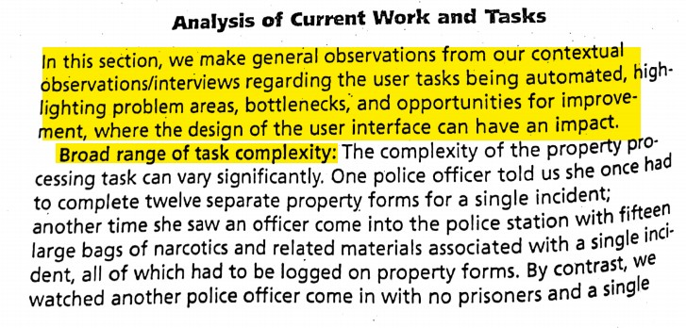
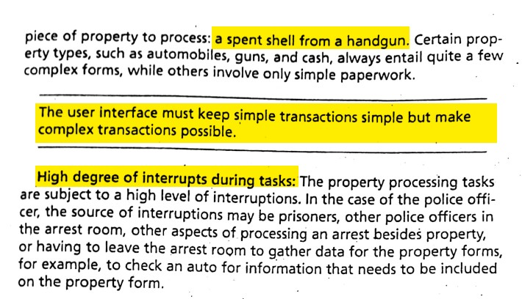

Slide 43
Simple simple, complex possible
CASE PUZZLE
5 min · optional · pairs
Customer A · 20 seconds
One strip of paracetamol, pays cash.
Customer B · 6 minutes
11-item prescription, two brands out, part quantities, on credit. Interrupted twice.
1
How few actions can Customer A’s sale take? List them.
2
Name two features that make Customer B possible without slowing Customer A.
3
Name one feature for the interruptions.
From Mayhew’s analysis: “keep simple transactions simple but make complex transactions possible” · “high degree of interrupts”.
Notes:
CASE PUZZLE, 5 minutes (optional — drop first if short of time). Use after the Analysis of Current Work and Tasks page.

Slide 44
Simple simple, complex possible — answers
ANSWERS
one interface, both customers
Customer A · 20 seconds
One strip of paracetamol, pays cash.
Customer B · 6 minutes
11-item prescription, two brands out, part quantities, on credit. Interrupted twice.
1 · Customer A
Type “pan…” → pick → quantity 1 → cash. Four actions; everything else has a default.
2 · Customer B
Substitutes shown when a brand is out
Credit and part quantities one step away, never in A’s path
3 · Interruptions
Park a bill, serve someone else, come back to it exactly as it was
Nothing lost on a time-out
Both principles came from watching real work — neither is in the SRS.
Notes:
ANSWERS. The pattern is progressive disclosure: the frequent, simple path is the default; complex options are available but out of the way.
Interruptions: Mayhew lists prisoners, other officers and leaving the room; here it is the phone, the queue and the delivery boy. The design response is the same — the task must survive being left half-done.

Slide 45
Stage 3:
Construct the user task organization model

Slide 46
Construct the user tasks organization model
In this stage Three steps are involved
Identify the basic user tasks
Take a first pass at a Current User Task Organization Model of those tasks
Obtain a Current user Task Organization Model of those tasks directly from users

Slide 47
Steps 9, 10 and 11
9. Identify basic user tasks
List the tasks from use cases and task scenarios, in the users’ own words
10. First pass user task organization model
The analyst groups the tasks the way he thinks users see them — a first guess
11. Obtain current user task organization model
Users sort task cards into groups and name the groups (card sorting)
Groupings shared by most users = the users’ model
Used later for menus and navigation
Notes:
Added slide (not in the original set), 2 minutes. It fills in Steps 9–11 from the process model.
Card sorting: each task on its own card; users sort into piles and name them; compare several users and keep the groupings most share.
Next: students do a card sort themselves on their own student portal.

Slide 48
Card sort: your student portal
LIVE EXERCISE
8 min · pairs · you are the users today
Check attendance
See my marks
Download fee challan
Check fee status
Register for courses
View timetable
Submit an assignment
Read announcements
Apply for hostel
Request a character certificate
Update phone number
See exam date sheet
1. Write each task on a small piece of paper (or just number them).
2. Sort them into 3–5 groups that make sense to you. No rules.
3. Give each group a name in your own words.
This is Step 11 in miniature: the users’ own organisation of their tasks.
Notes:
LIVE EXERCISE, 8 minutes in pairs. Students are real users of the university portal, so this is a genuine card sort.
Collect group names from four or five pairs on the board before showing the answer slide; look for groups named by time (“start of semester”) or purpose.
If a pair asks “where does announcements go?” — that is the point: there is no right answer, only the users’ answer.

Slide 49
Card sort — two ways to organise the same tasks
ANSWERS
compare with the groups on the board
A typical developer’s menu
One student pair’s groups (example)
Academics
attendance · marks · course registration · timetable · assignments · date sheet
Every day
timetable · announcements · attendance · submit assignment
Finance
fee challan · fee status
Start of semester
register · fee challan · fee status · hostel
Services
hostel · character certificate
Exam time
date sheet · marks
Profile / Notices
phone number · announcements
Once in a while
character certificate · phone number
Developers group by department or data; users often group by when and why. Step 11 finds the users’ version.
Notes:
ANSWERS. The student grouping is an example, not the answer: compare it with what the class produced.
Mayhew’s point: the current user task organisation model comes from users, not from the analyst’s first pass (Step 10). With several users you look for groupings most of them share.
This model feeds menu structure and navigation later in the course (conceptual model design).

Slide 50
Which step is this?
QUIZ
4 min · optional · alone · write the step number
Read the owner’s requirements document
Ask the developer what the system must automate
1
2
List actors: salesman, owner, customer, rep
Sit behind the counter 7–9 pm, noting every sale
3
4
Note load-shedding, glare and noise, with implications
Write “At 8:40 pm a man brings his father’s prescription …”
5
6
Write up scenarios, error rates and bottlenecks
Salesmen sort 30 task cards and name the piles
7
8
Use the three process-model slides from the start of the lecture.
Notes:
QUIZ, 4 minutes (optional — drop second if short of time). Alone, then show the answers.

Slide 51
Which step is this? — answers
ANSWERS
the 11-step process model
Read the owner’s requirements document
Ask the developer what the system must automate
1
STEP 1
2
STEP 2
List actors: salesman, owner, customer, rep
Sit behind the counter 7–9 pm, noting every sale
3
STEP 4
4
STEP 5
Note load-shedding, glare and noise, with implications
Write “At 8:40 pm a man brings his father’s prescription …”
5
STEP 6
6
STEP 7
Write up scenarios, error rates and bottlenecks
Salesmen sort 30 task cards and name the piles
7
STEP 8
8
STEP 11
Stage 1 = Steps 1–4 · Stage 2 = Steps 5–8 · Stage 3 = Steps 9–11
Notes:
ANSWERS. Colours: blue Stage 1, green Stage 2, brown Stage 3. Steps 3, 9 and 10 are not in the list — ask what they would look like at the pharmacy.

Slide 52
Exit ticket
LIVE EXERCISE
5 min · alone, on paper · hand in at the door
Name one thing you would learn only by watching users at work, not in an off-site interview — and why.
1
Write one task scenario for the use case “pay the hostel mess bill”. No interface words.
2
What is still unclear after today?
3
Lab 6 — Task Analysis in FigJam: before the lab, observe one person doing your project’s core task for 20 minutes and bring your notes.
Notes:
EXIT TICKET, 5 minutes. Collect at the door; use answers to question 3 to open next week.
Question 2 marking: a person, a time or situation, a goal and at least one constraint; no “tap”, “screen”, “menu”.

Slide 53
Reference
The Usability Engineering Lifecycle by Deborah J.Mayhew, Chapter 03

Slide 54
End of the Lecture

